Slide 1
Formula 1 Driver Analyser A Visual Analytics Project
Luca Sannino 1542194

Slide 2
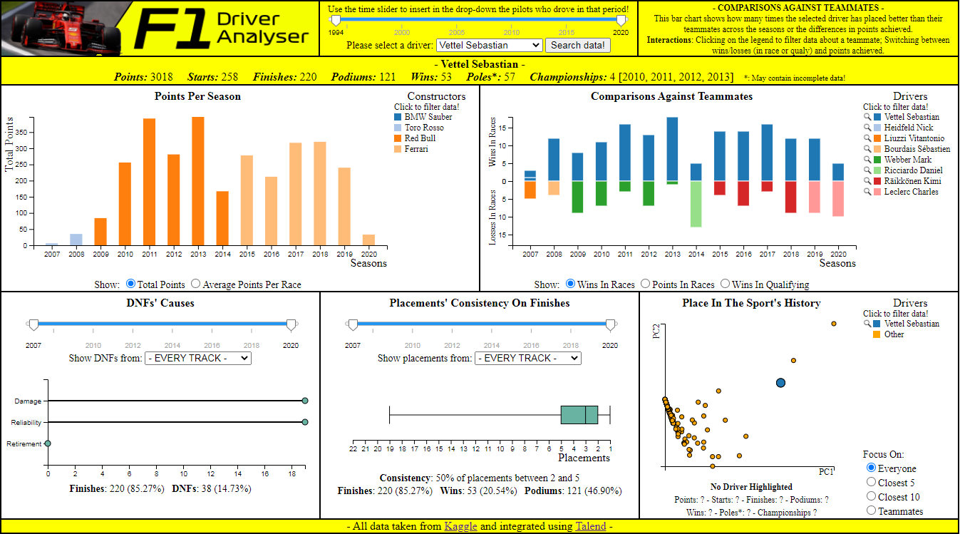
Brief Overview
“Driver Analyser” is a Javascript application that uses the D3.js library to create an interactive visual environment that displays stats about the career of a user-selected Formula 1 driver.

Slide 3
Target User
The target user is someone interested in having a greater understanding of a driver’s performance.
It can be someone internally in the teams themselves who is looking for the next best hire.
Or it can be just a passionate fan, the type that spends hours discussing which driver is better and why.
Or it can be just someone who likes to bet and win (hopefully) some easy money.

Slide 4
Target User
What may a user be interested in? Let’s try to guess it with a list!
● Is the driver on an upward trajectory, or are his best days clearly behind him?
● How does his performance compare against the ones of his teammates across his career?
● Does he get DNF’d often? If so, it’s because he is a hothead who constantly gets involved in crashes/collisions, or it’s due to unlucky reliability issues?
● How constant he is in his placements? In which constructor did he gain the better results? In which circuits?
● How does he fit in the history of the sport itself, in terms of achievements reached?

Slide 5
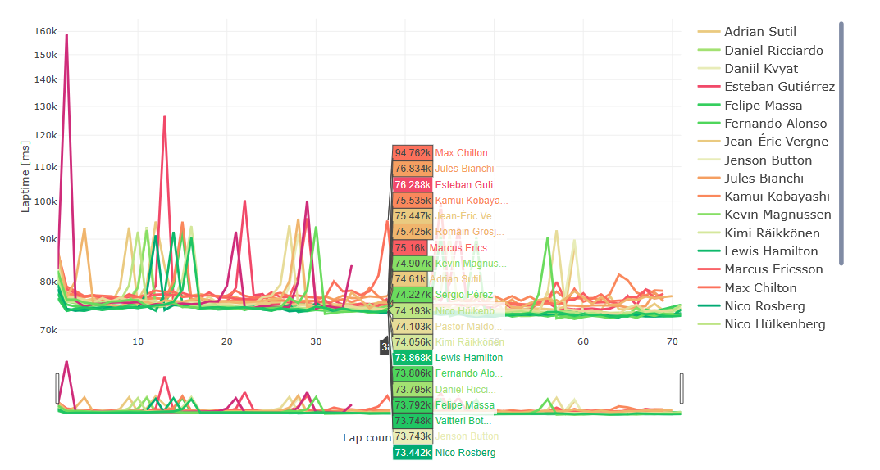
Related Works
Is there already another work that has the same target of studying F1 drivers’ performances? Sort of!
This is “Visual Analysis of F1 races” by Lampprecht et al.

Slide 6
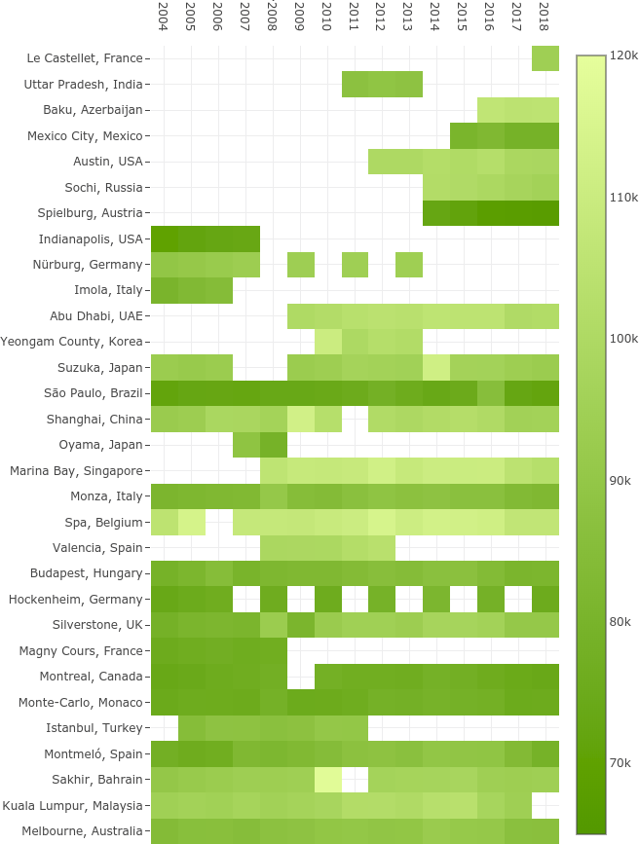
Related Works
Even though the work of Lampprecht et al. is still finalized to the study of a driver’s performance, there is one key difference.
That environment is “race-focused”, meaning that a user can learn about the drivers’ performances only in relation to a given race that is selected through a calendar chart, so that they have later the possibility to inspect their times down to single laps in a timeline graph.

Slide 7
Related Works
This work, instead, is meant to offer a “driver-focused” prospective, meaning that users get to choose drivers in order to gain a better knowledge about their performances in relation to the entire stretch of their careers, and not for a race in particular.
This work is then meant as companion piece, since both tools together can now allow analyses that can be both focused on more narrower details, or that can look at the bigger picture.

Slide 8
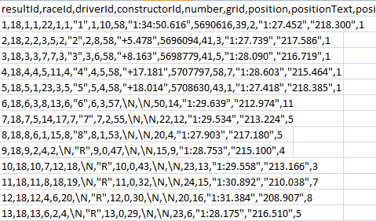
The Source Dataset
Thankfully a .csv dataset that contains stats about the entire history of Formula 1 is easy to find on Kaggle, courtesy of user Rohan Rao. The problem, though?
The dataset needs to be integrated before it is usable!

Slide 9
The Source Dataset
In ordert to integrate it, first I created the GAV mappings, which are new global schemas that act as views over the source ones. Here’s an example:
Source Schemas
results(…, raceId, driverId, constructorId, …, position, …, points, …, statusId) races(raceId, year, round, circuitId, name, ..) circuits(circuitId, …, name, …) driver(driverId, …, forename, surname, …) constructors(constructordId, …, name, …) status(statusId, status)
Global Schema
results(year, round, grandprix, circuit, surname, name, constructor, position, points, status)
GAV Mapping
{ (a, b, c, d, e, f, g, h, i, l) |
results(…, x1, x2, x3, …, h, .., I, …, x4), races(x1, a, b, x5, c, …), circuits(x5, …, d),
driver(x2, …, e, f, …),
constructors(x3, .., g, …),
status(x4, l)
} => results(a, b, c, d, e, f, g, h, i, l)

Slide 10
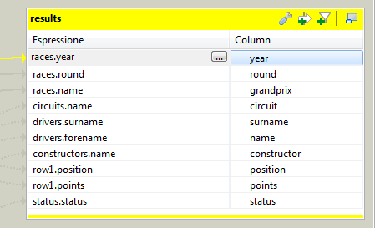
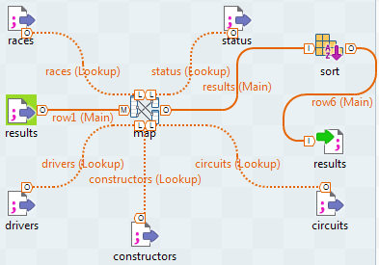
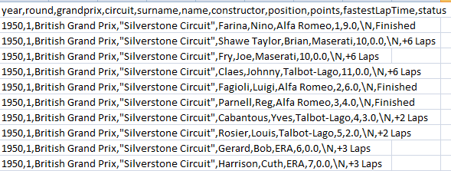
The Source Dataset
Then I used Talend Open Studio to apply those GAV mappings and finally obtain a ‘friendlier’ and focused version of the starting dataset.

Slide 11
Visualizations
The visualizations focus on the aspects of a driver’s career that are of particular interest, like points achieved, results against their teammates, DNFs and consistency of their placements.
In short they are meant to answer the questions asked in that list discussed previously.
Such visualizations include bar graphs, lollipop charts, box plots and scatter plots on multidimensional data achieved through PCA.
They also are interactive and synchronized between each other.

Slide 12
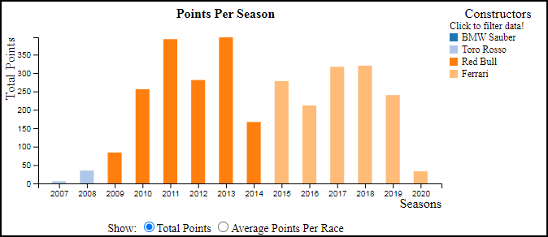
Points Per Season
This is a bar graph where every bar represents the points achieved by the driver across each year of his career.
The bars are also colored, so that the user knows the constructors they are associated with thanks to a legend that is near the graph.
If a pilot has driven for more constructors in the same year, then the bars are stacked on top of each other.

Slide 13
Points Per Season
Users can highlight bars by hovering the mouse on them or the legend
User can filter off constructors by using the legend
Users can switch between two units of measures
Users can calculate new means by clicking on the bars

Slide 14
Points Per Season
I think this visualization is useful because it gives a quick overview of where the driver was at the peak of his career, and where at the bottom.
In this way, by interacting with the legend, the user can entirely focus only on those stretches of time under particular constructors that caught their eye, filtering out from this chart and all of the others information that may be considered useless or superfluous at the task at hand.

Slide 15
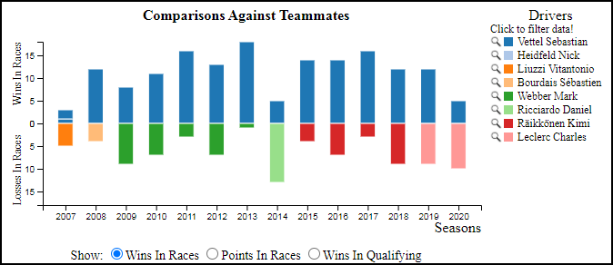
Comparisons Against Teammates
This is a diverging bar chart where all the bars above represent the number of wins of the selected driver against his teammates across all the years of his career, while the bottom bars represent the losses.
Winning against a teammate means placing above him in an event, no matter the position, while losing means the opposite.
It is possible to switch between wins in races and qualifying, or to visualize just the differences in points achieved.
The bottom bars are colored as well, so that the user can check which teammates are being represented on the legend.

Slide 16
Comparisons Against Teammates
Users can highlight bars by hovering the mouse on them or the legend
User can filter off teammates by using the legend, or select a new driver by clicking on the magnifiyng glass.
Users can switch between wins in races, wins in qualyfing or points in races.

Slide 17
Comparisons Against Teammates
Since in Formula 1 cars belonging to different constructors have different specs, I thought that a comparison between teammates is the closest you can get to a comparison that feels ‘fair’, or at least reasonable, in order to extract how good a driver is.
By switching between races and qualifying, it is possible to guess if a driver can drive faster than a teammate (more wins in qualifying) at the cost of a worse race pace (more losses in races), and vice versa.
By switching to the differences in points achieved it is possible to assign a more meaningful value to the differences in wins/losses, since it’s one thing to have more wins when we are dealing with races that net no points, another is to win that important race that instead scored a lot of points.

Slide 18
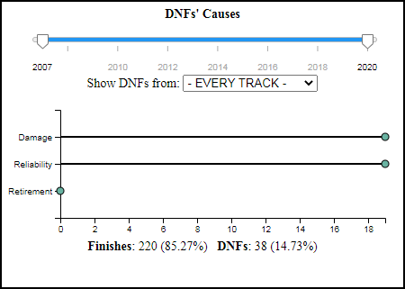
DNFs’ Causes
This is a lollipop chart that shows the number of DNFs of the selected driver, divided in three macro categories: Damage, Reliability and Retirement.
Damage includes cases of external damage to the car (tyre punctures, broken wings etc.) that are the consequence of collisions with the track or other drivers.
Reliability include all cases of internal issues (power loss, overheated engines, brakes failures etc.) that are beyond the driver’s responsibility.
Retirement includes the cases where the driver voluntarily drove to the pit line in order to quit the race.

Slide 19
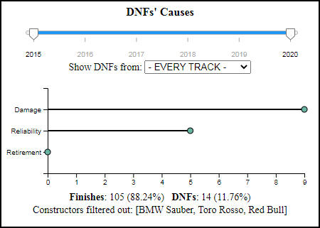
DNFs’ Causes
User focus on all tracks or select one in particular.
User focus on a particular range of time.
Users can hover on the points to see additional info.
Users can filter on previously disabled constructors.

Slide 20
DNFs’ Causes
The reason I decided to focus on these three macro categories was because the status.csv file contained hundreds of different reasons for a DNF, far too many to be reasonably visualized.
So I decided to incorporate them in macro categories, so the user could instantly see if a driver gets DNFed because he always manages to get himself in the worst position at the worst time (high number of Damage DNFs), or if he’s just unlucky and it’s all the car’s fault (high number of Reliability DNFs).
The short number of values visualized (only three) is partially off-set by the fact that the scale of the x-axis doesn’t change when moving the time slider, so the user can see how the current values fare in relation to the whole.

Slide 21
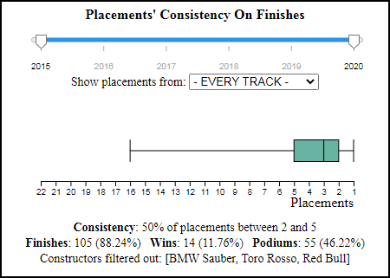
Placements’ Consistency
This is a box plot that shows the distribution of the placements when the driver actually reaches the finish line.
User focus on all tracks or select one in particular.
User focus on a particular range of time.
Users can filter on previously disabled constructors.

Slide 22
Placements’ Consistency
The reason I decided to use a box plot was because I felt there wasn’t anything better that could instantly showcase how the performance of a driver increases or degrades when certain time periods and constructors are selected, because all the user needs to do is focus on where the quartiles of the distribution are.

Slide 23
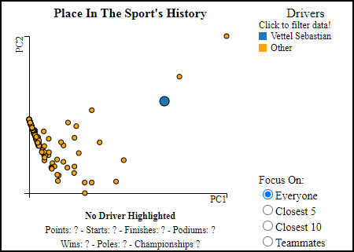
Place In Sport’s History
This is a scatter plot that shows where a driver, identified by a circle, stands against all the other drivers, also identified by circles, in terms of achievements. The closer two drivers are, the more similar their achievements are.
The points are the result of executing PCA on 7-dimensional tuples that contain some of the most important achievements for each driver: points, starts, finishes, poles, podiums, wins and championships.
The axis of the scatter plot are the two principal components that better express the variance of the dataset.

Slide 24
Place In Sport’s History
User can filter off teammates by using the legend, or select a new driver by clicking on the magnifiyng glass.
User can focus on different areas of the scatter plot.
Users can hover on the points to see additional info.

Slide 25
Place In Sport’s History
I thought this chart was useful because you can hover over the names of the teammates in the Comparisons Against Teammates chart and highlight the corresponding circles in the PCA (and vice versa).
This way a user can see how strong a teammate is, so that they can attribute the right “value” to some of the wins/losses (a rookie losing against a far more skilled and awarded teammate is way less severe than the opposite situation).

Slide 26
Limitations
Even though the dataset promised complete stats from the fifties to today, not only qualifying data starts only from 1994, but there are also some short gaps even after.
This forced me to use an asterisk near every value that expresses the number of pole positions, which notifies the user that such stats may contain missing information.

Slide 27
Limitations
I wish I could have implemented more filters for the ‘Comparisons Against Teammates’ chart, for example visualizing the wins/losses in races where only both drivers achieved a certain threshold of points, or filtering out races where one of them suffered from a reliability issue that prevented him from reaching the better place against the teammate.
Also, I wish I could have implemented a toggle that lets the DNF chart display more categories in order to satisfy the more demanding users that want to know the exact reason behind a DNF.

Slide 28
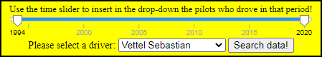
Limitations
Lastly, I wish I could have implemented the initial selection of a driver through visualization, and not through the time unusual slider/drop-down combo.
However I could not think of anything that did not feel “gimmicky”, meaning that it used visualization just for the sake of it, so I settled for something that I felt to be more intuitive.

Slide 29
Conclusion
I feel that “Driver Analyser” offers a quick and intuitive way to gain a greater understanding of a driver’s career, where a lot of meaningful insights can be made just with a short series of ‘clicks’.
… of course it’s no match for a more professional tool that is built on a larger quantity of data not publicly available!

Slide 30
References
D3.js: https://www.talend.com/
Visual Analysis of Formula One Races: https://www.researchgate.net/publication/333480821_Visual_Analysis_of_Formula_One_Races
Dataset: https://www.kaggle.com/rohanrao/formula-1-world-championship-1950-2020
Talend Open Studio: https://www.talend.com/

